Slide 1
JDemetra+ as an innovative tool for seasonal adjustment
Sylwia Grudkowska
sylwia.grudkowska@ecb.europa.eu
ECB/Macroeconomic Statistic Division
Conference of European Statistics Stakeholders
Budapest, 2016

Slide 2
Content
JDemetra+ as an innovative tool for seasonal adjustment
Seasonal adjustment methods and software
Software development
JDemetra+
Structure
Characteristics
Differences to the original programs
Future product development

Slide 3
Leading seasonal adjustment methods
JDemetra+ as an innovative tool for seasonal adjustment
The main seasonal adjustment (SA) programs are:
TSW – the Windows application, developed by the Banco de España, that integrates the TRAMO and the SEATS programs;
X-13ARIMA-SEATS – produced by the U.S. Census Bureau, include enhanced X-12-ARIMA method and is capable to generate ARIMA model-based SA.
Both algorithms are written in FORTRAN; they are not designed for reusability
In case of introduction of the new functionality, the actual programs are modified
Uncertain future of the FORTRAN language
Lack of developers
Not an object-oriented language

Slide 4
The development of software for seasonal adjustment in the European Union
JDemetra+ as an innovative tool for seasonal adjustment
2002
Demetra
Program to compare X-12-ARIMA and TRAMO/SEATS (1997/98)
2010
Demetra+
Developed in cooperation between Eurostat and the National Bank of Belgium
2015
JDemetra+
Fortran codes re-written in JAVA
Lack of sufficient product development and handling of errors as a result of a loss of technical knowledge about software
Integration of original software in a user-friendly application
Enables the implementation of the ESS Guidelines on SA
Provides graphical interface and common input/output diagnostics for TRAMO/SEATS and X-12-ARIMA
Includes complex technical solutions. Uses .NET technology and can be used only under Windows
Open source, platform independent
Developed by the National Bank of Belgium, supported by the Deutsche Bundesbank for the X-11 part
Extensible graphical interface, based on the NetBeans platform (plugins)
Tested and promoted by the Seasonal Adjustment Centre of Excellence (SACE), launched by Eurostat
As of as of February 2015, recommended by the Seasonal Adjustment Expert Group as software for conducting seasonal adjustment of official statistics in the European Union

Slide 5
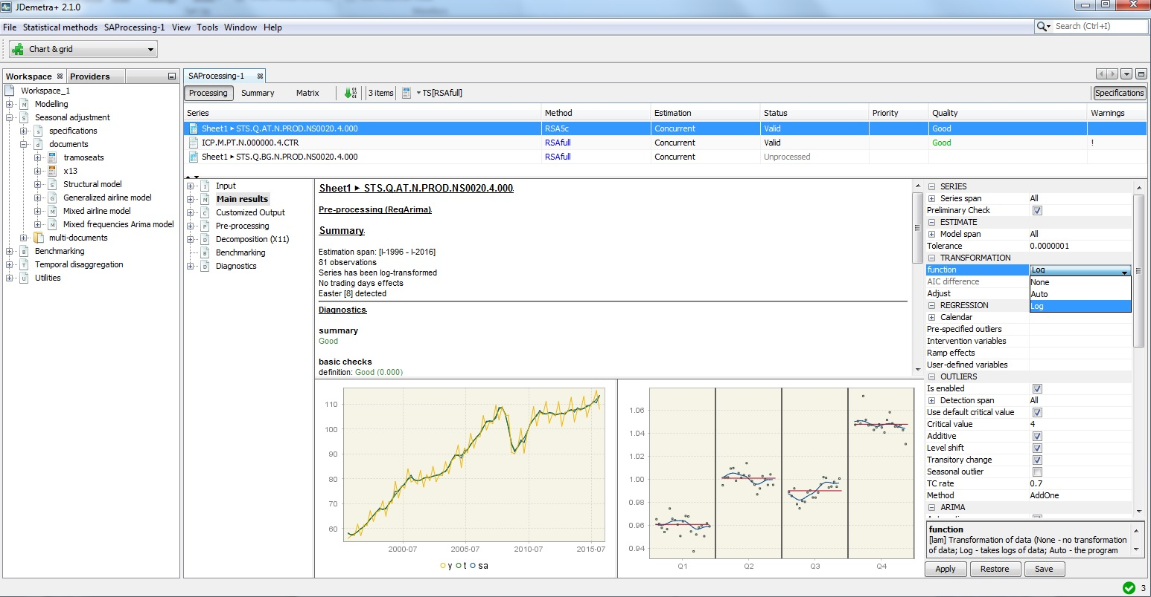
JDemetra+ interface
JDemetra+ as an innovative tool for seasonal adjustment

Slide 6
JDemetra+ structure
JDemetra+ as an innovative tool for seasonal adjustment
Java language
JTsToolkit
Core algorithms
In house developments
External
packages
Peripheral modules
NetBeans technology
NetBeans
JDemetra+ plug-ins
External plug-ins

Slide 7
JDemetra+ distinctive features
JDemetra+ as an innovative tool for seasonal adjustment
Flexibility
Encompasses the leading SA algorithms
Could evolve independently when improvements or alternative methods appear
Versatility
Can be used in a rich graphical interface (JDemetra+ itself)
Can be integrated in other (in-house) developments
Reusability of modules
JEcotrim (for temporal disaggregation)
Usage of the libraries of JDemetra+ for outlier’s detection
Estimation of missing values, forecasts, calendarization
Extensibility
Additional plug-ins and modules do not change the core engines
Efficient processing of large datasets
JWSAcruncher, command line application that allows calling JDemetra+ from other applications
Web services
Direct call to Java libraries
Open source
Contribute to increase the transparency of statistical computation and a better sharing of the statistical knowledge
Possibility for different teams to progressively take over the software or to contribute to its evolution
Plug-ins developed by SA experts can be shared with the community members

Slide 8
The implementation of the original programs in JDemetra+
JDemetra+ as an innovative tool for seasonal adjustment
The structure of the Java code differs profoundly from the original codes
JDemetra+ uses a common skeleton for the pre-processing steps of X12/X13 and for Tramo
For performances and/or design reasons, the used algorithms (estimation of Reg-Arima models, maximization of the likelihood…) will not always follow the original solutions
From a theoretical point of view, no impact on the results, from a practical point of view, impact usually marginal (due to different local solutions in optimization problems…)
Perfect comparability for X11, punctual differences in SEATS
JDemetra+ is faster and more robust to invalid adjustments than X12/X13

Slide 9
Migration to JDemetra+
JDemetra+ as an innovative tool for seasonal adjustment
Migration is relatively easy when seasonal adjustment software is used as a stand-alone application
In case of an integrated data production environment:
Changes in the production scheme
Analysis of the JDemetra+ code
Need for additional functionalities (data providers, tailor-made reporting, check-in/check out facilities…)
Extensive tests
Documentation
Maintenance
Support offered by the SACE
Migration of specification files differences in implementation

Slide 10
Product development
JDemetra+ as an innovative tool for seasonal adjustment
Plugins (* indicates planned plugins)
Other statistical topics
Structural models and other advanced model-based seasonal adjustment methods
Chain-Linked Indices Aggregation and Disaggregation
Benchmarking, temporal disaggregation
Dynamic factor models (nowcasting)
Business cycle analysis*
Bayesian VAR*
Revision analysis
Seasonal adjustment tools
Enriched output
Parsers for translating X-12 spec files to JDemetra+
Enhanced direct/indirect SA and balancing tool*
Others
Data providers for SDMX WEB services
Light scripting language (for batch processing)*
A common pre-processing module

Slide 11
Links
JDemetra+ as an innovative tool for seasonal adjustment
JDemetra+ repository on Github: https://github.com/jdemetra
This presentation is available on: https://github.com/SylwiaGrudkowska/JDemetra/
Support, documentation and more:
https://ec.europa.eu/eurostat/cros/content/seasonal-adjustment_en

